Slide 1
Reliance Industries Stock Forecast
Group-5
Project no. P-181
Date:
Group Number | Name | Mail id | Contact Number | Previous project | Location | Trainer Name
5 | Mr. Sanath Shanmugam | sanathshannu12@gmail.com | 7022444380 | P162, P170 | Bengaluru | Mr. Ritesh
 | Mr. Ronit Kumar Nayak | ronitnayakix@gmail.com | 7470946215 | P162, P170 | Bengaluru | Mr. Ritesh
 | Ms. Padma Priya Dagani | priyapadhu13@gmail.com | 8331885150 | P162, P170 | Hyderabad | Advaith
 | Rahul Boyidapu | rahullals1234@gmail.com | 7036629190 | P162, P170 | Bangalore | Neha
 | Dr. Madhu T S | madhuts2327@gmail.com | 9844494188 | P162, P170 | Bangalore | Bharadwaj
 | Mr. Moulishwaran C | moulishwaran30@gmail.com | 8903376076 | P168 , P160 | Bangalore | John Gabriel

Slide 2

Business Problem ::
Predict the Reliance Industries Stock Price for the next 30 days.
There are Open, High, Low and Close prices that you need to obtain from the web for each day starting from 2015 to 2022 for Reliance Industries stock.
Split the last year into a test set- to build a model to predict stock price.
Find short term, & long term trends.
Understand how it is impacted from external factors or any big external events.
Forecast for next 30 days.

Slide 3
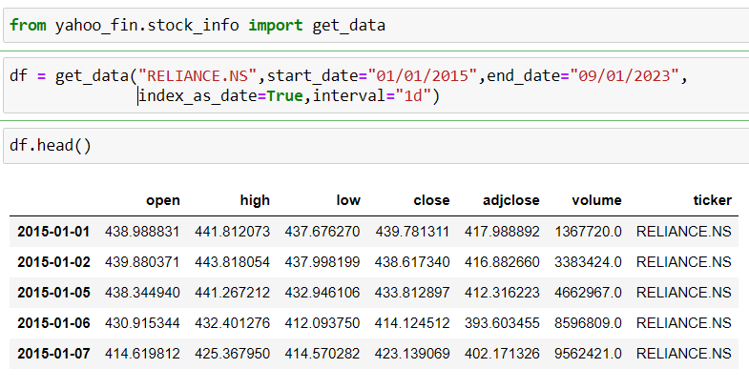
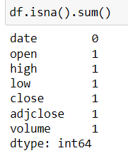
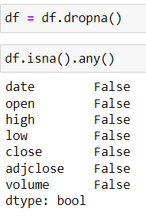
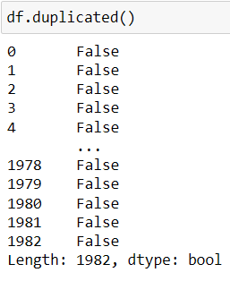
Loading DATASET
Used yahoo_fin.stock_info to derive the data
Data Pre-Processing
There was one null value in the derived data
We dropped the null value
Then we checked for any duplicated value, there is no duplicate value in this dataset

Slide 4
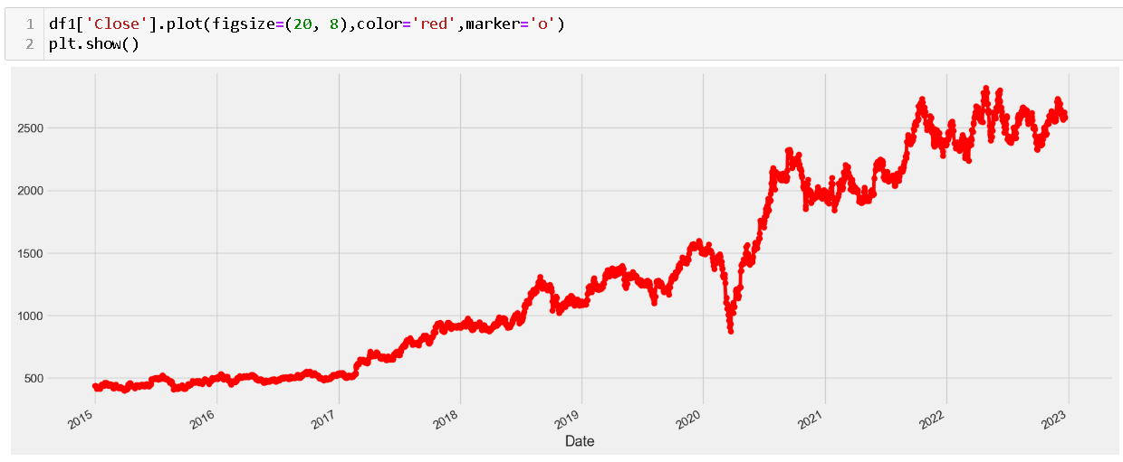
Plot showing the Closing price of the stock over the years

Slide 5
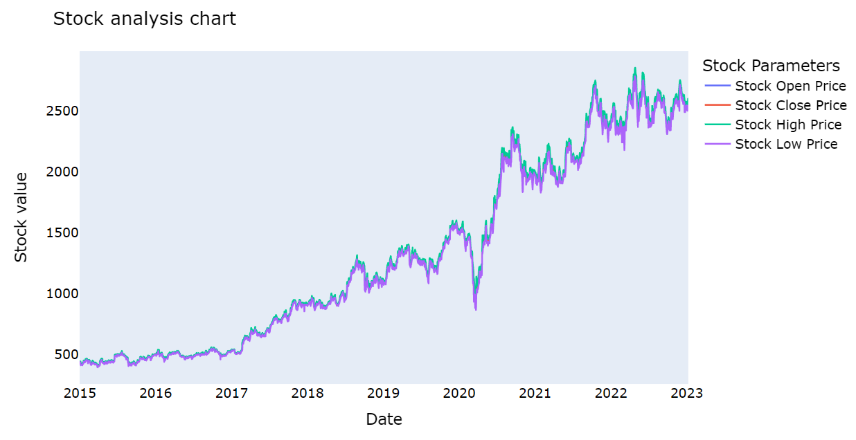
Trend comparision between stock price, open price, close price, high price and Low Price

Slide 6
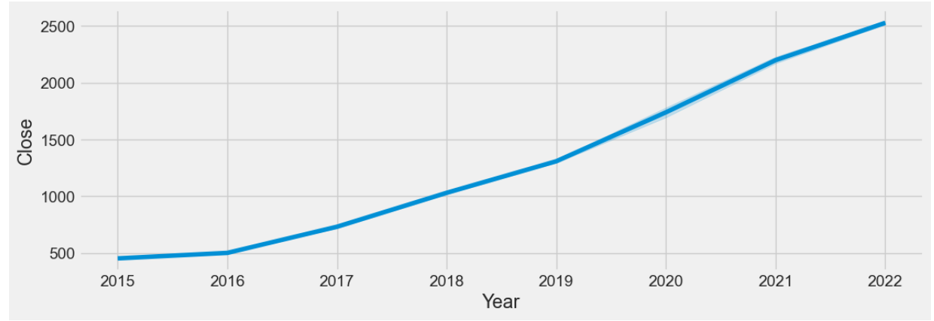
Trend of the Closing price of the Stock over the years

Slide 7
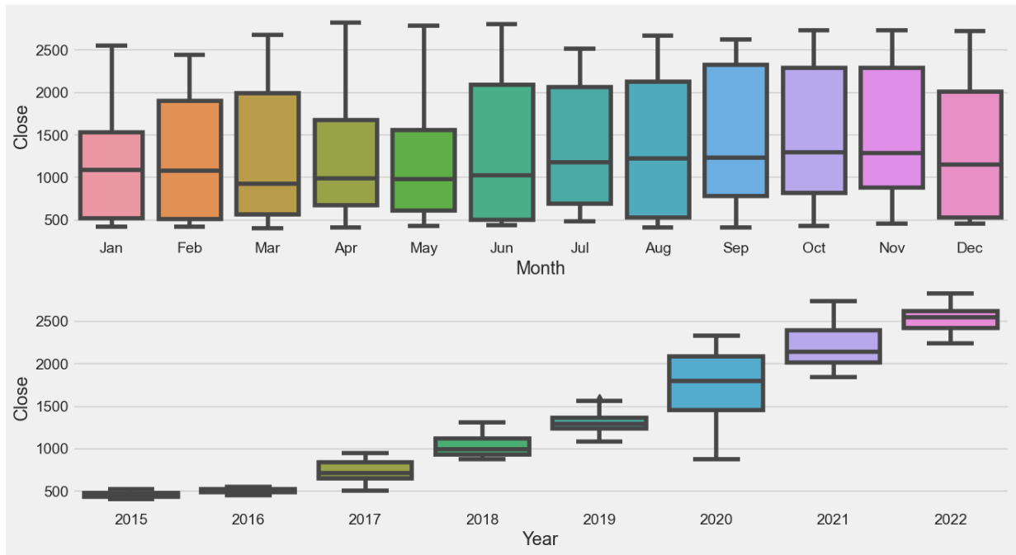
Closing Price comparison with months and over the years

Slide 8
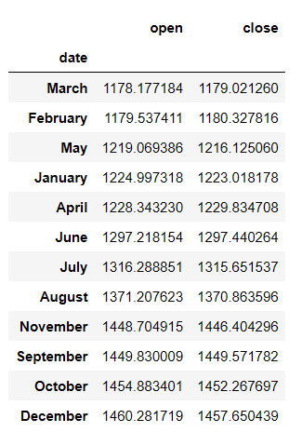
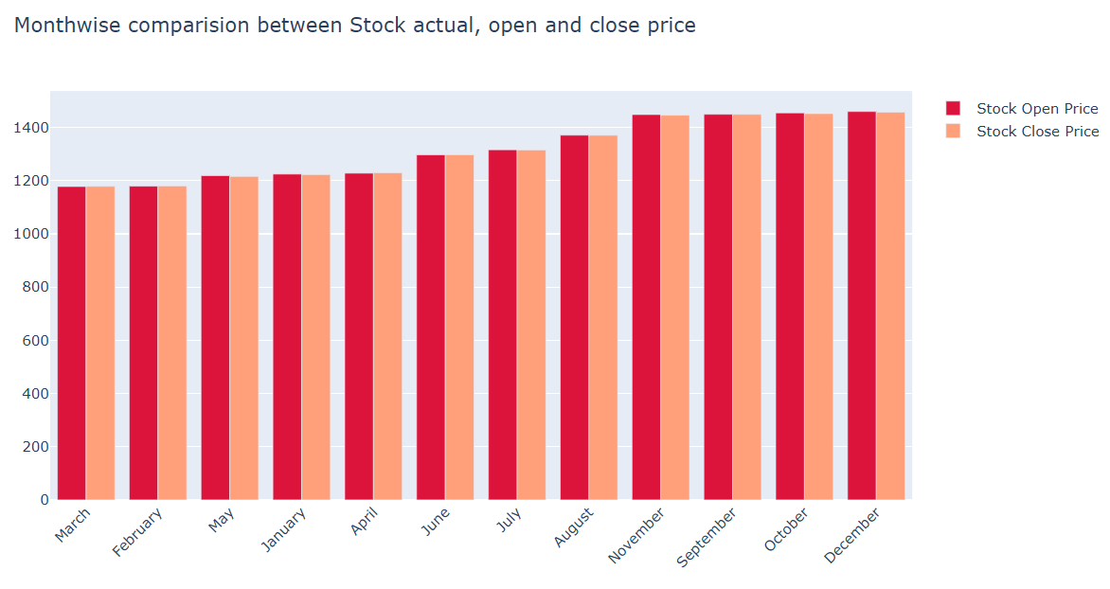
Month-wise comparison of Open and Close price of the Stock

Slide 9
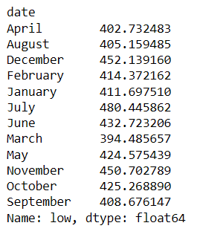
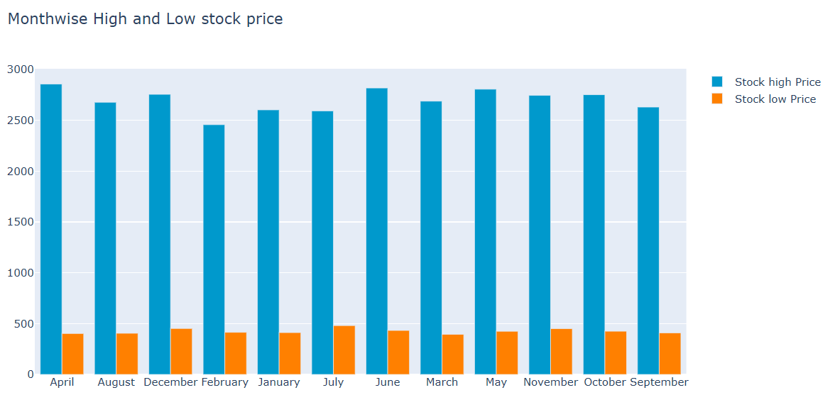
Month-wise comparison of High and Low price of the Stock

Slide 10
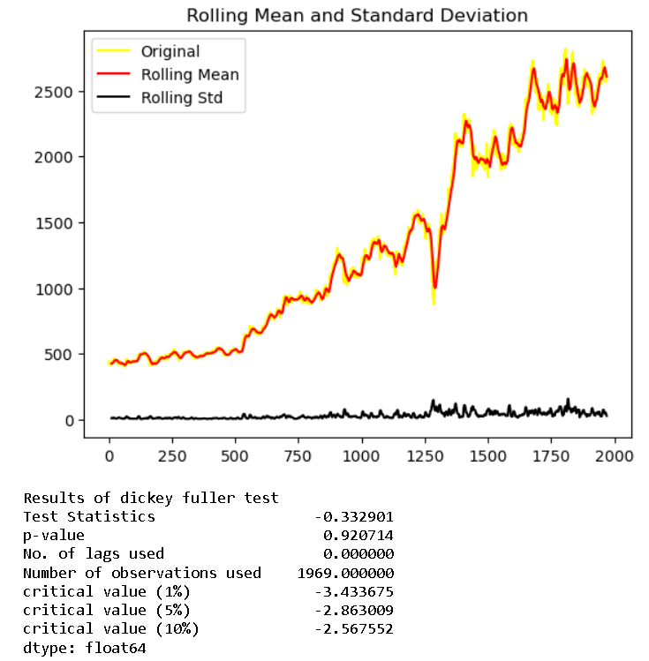
Dickey-Fuller Method to check Stationarity

Slide 11
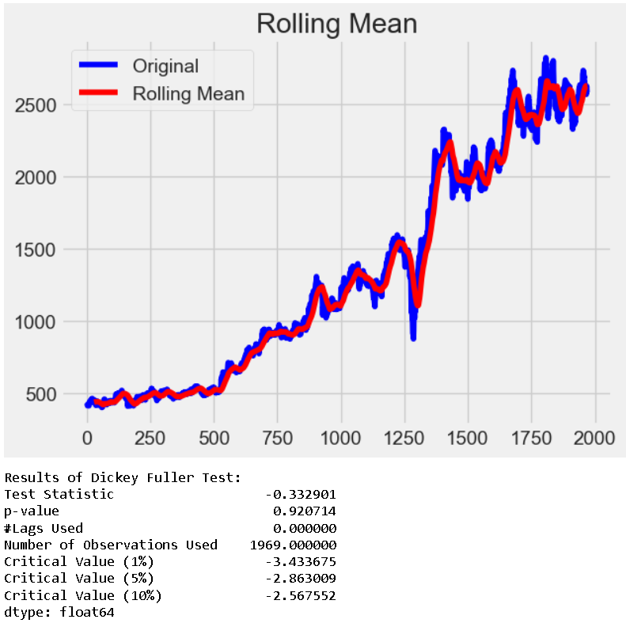
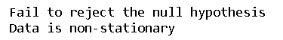
The data is not stationary, hence we had to do a little transformations

Slide 12
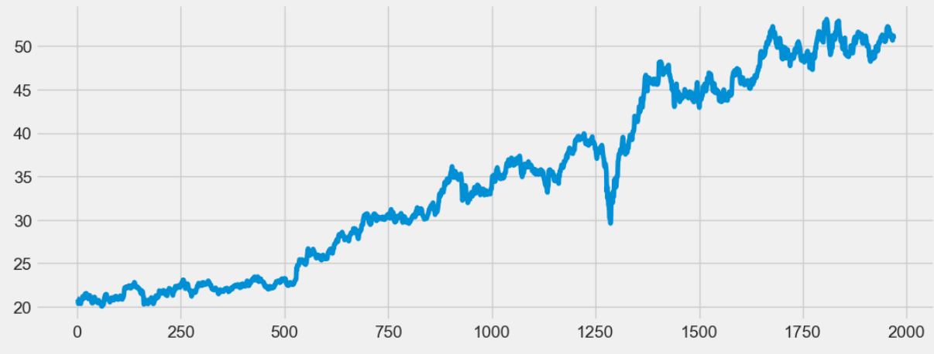
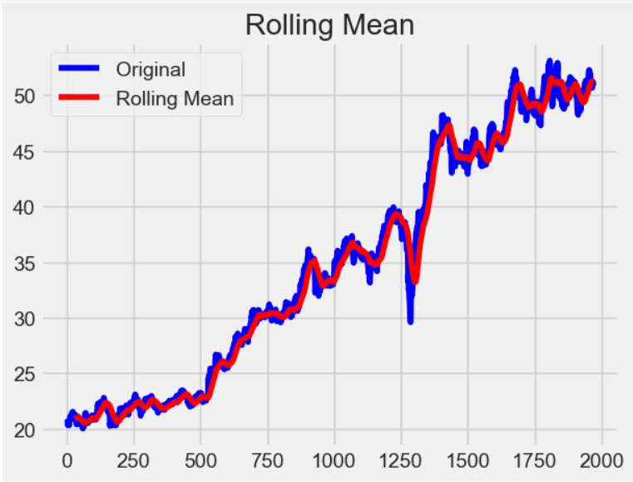
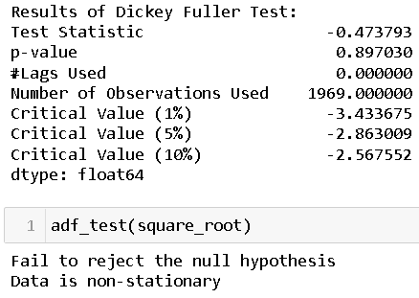
Performed Square Root Transformation

Slide 13
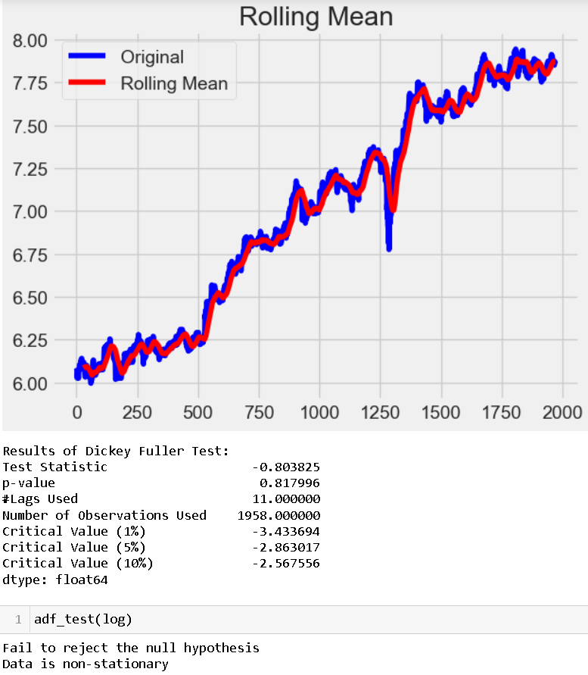
Even upon doing Log Transformation the result was the same :
The data was not stationary.

Slide 14
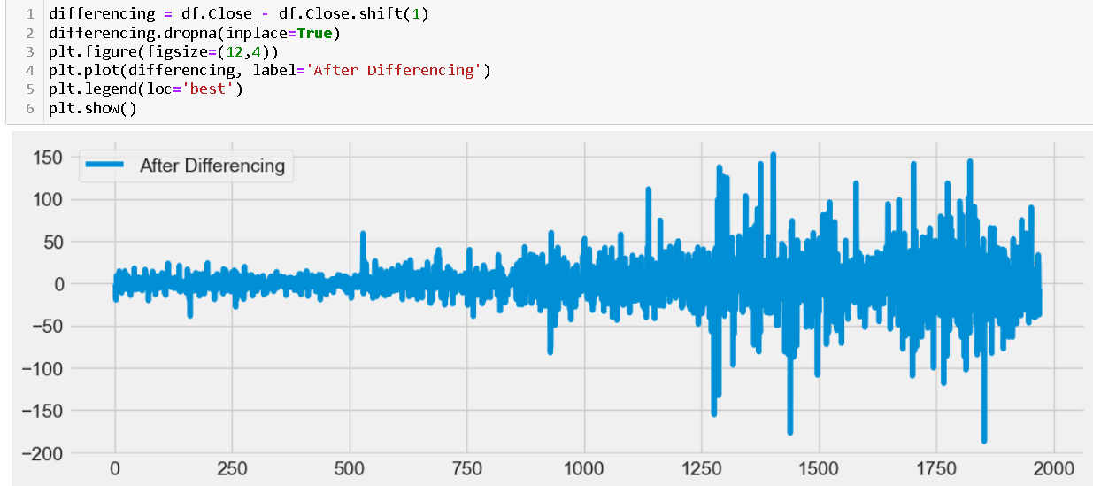
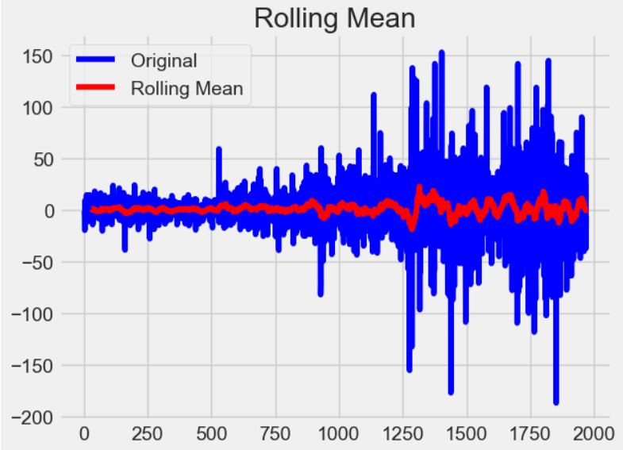
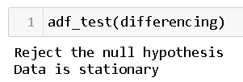
Applied Differencing to the data and the result was that the data at last was stationary

Slide 15
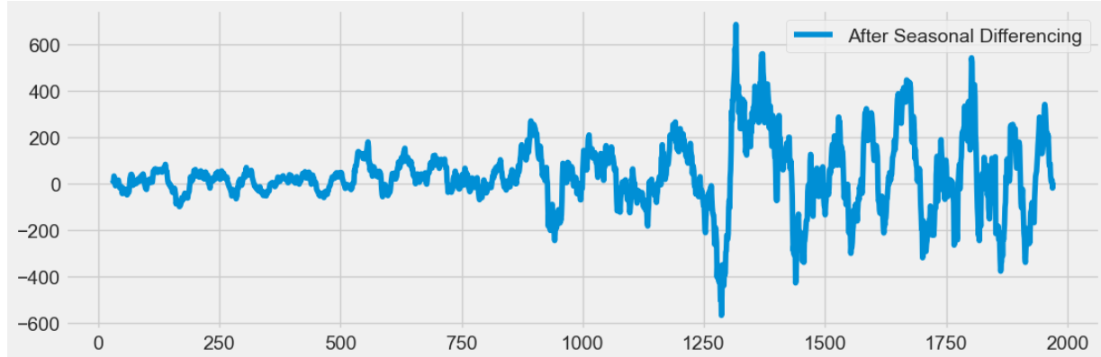
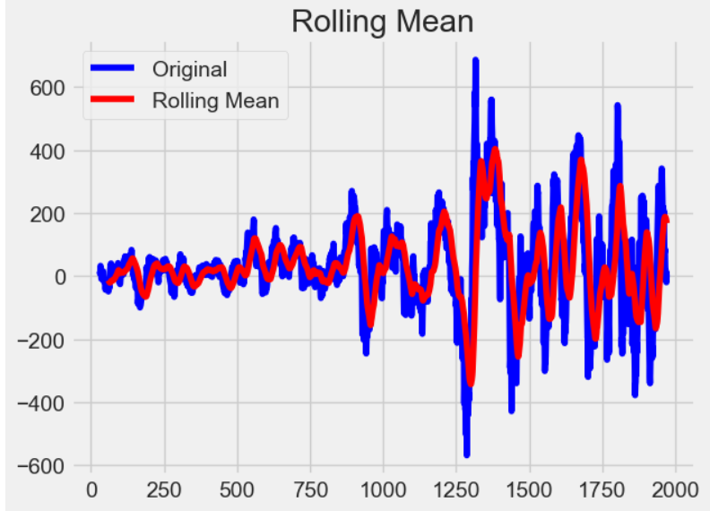
After adding the element of seasonality, the seasonal difference was performed and the data was still stationary

Slide 16
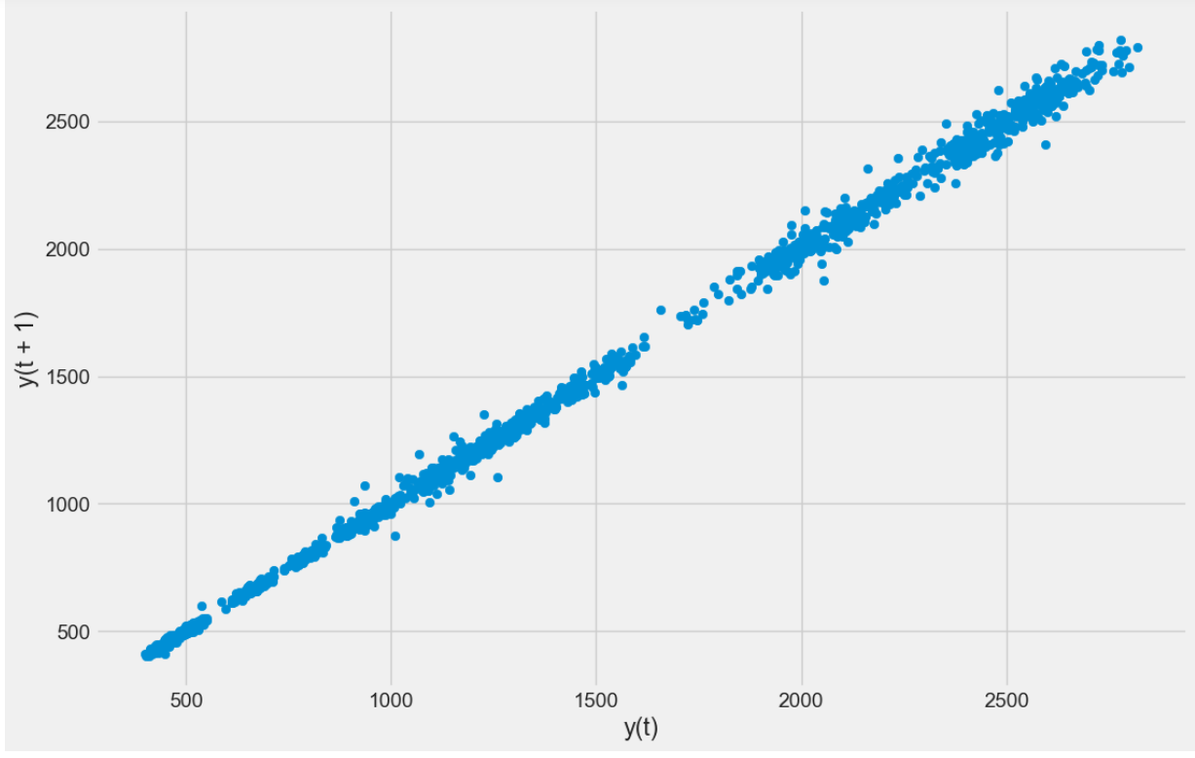
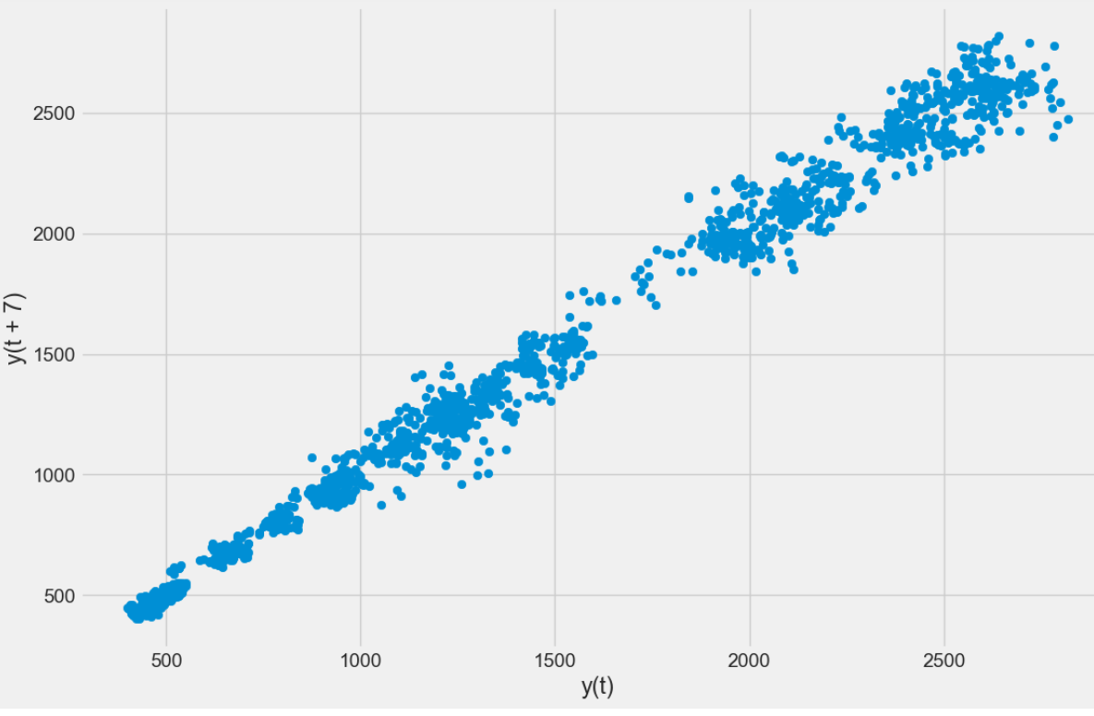
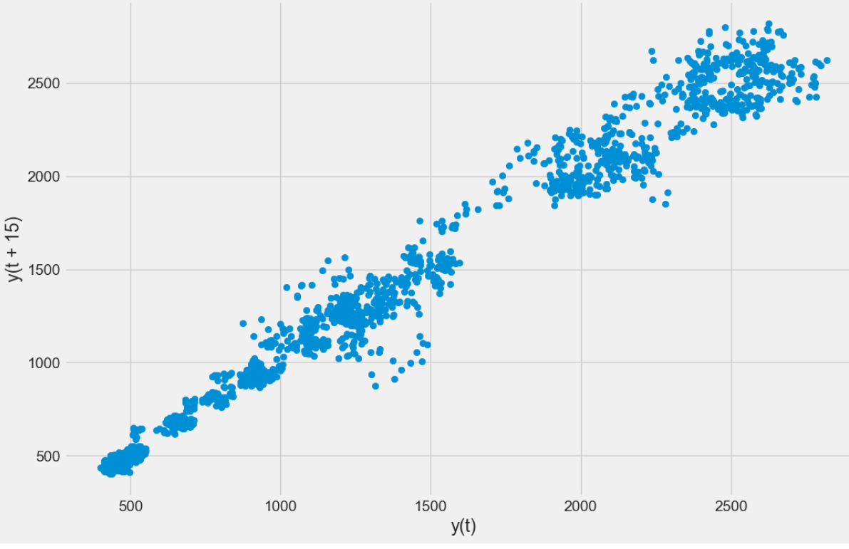
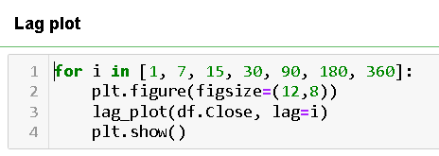
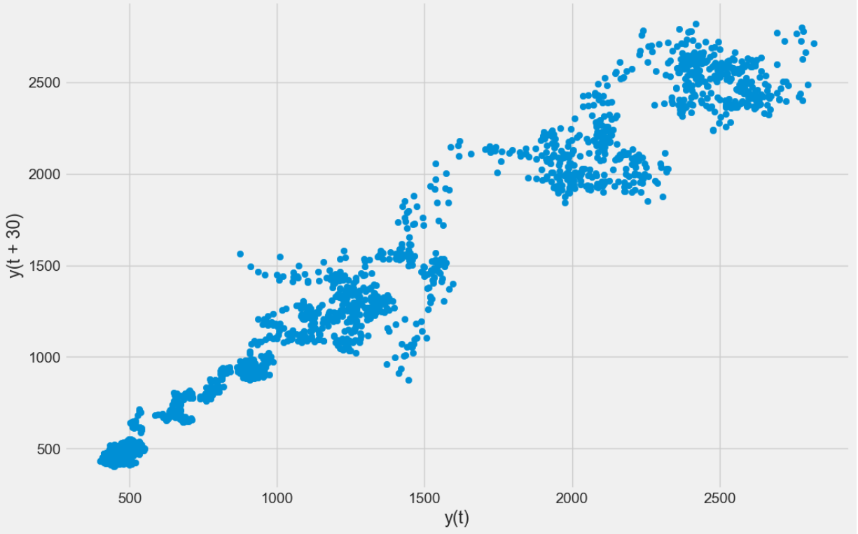
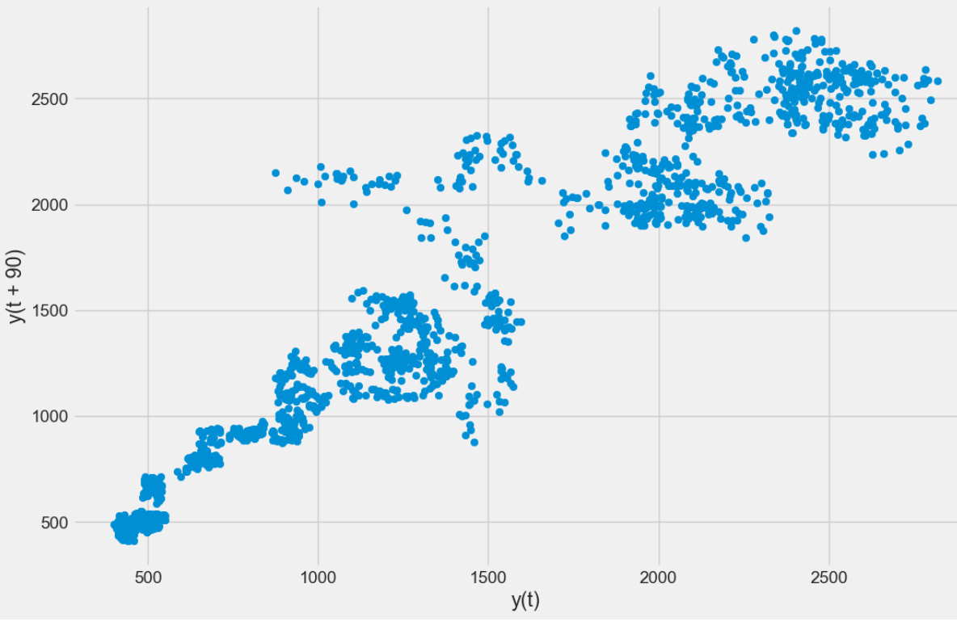
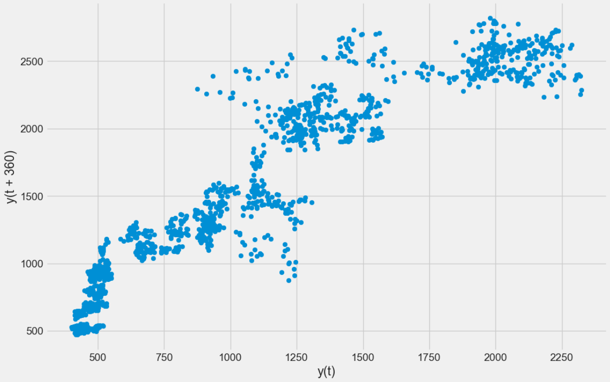

Slide 17
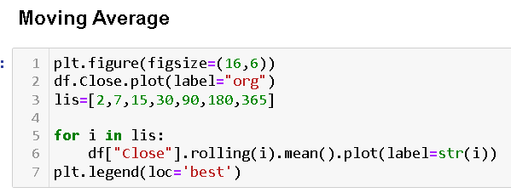
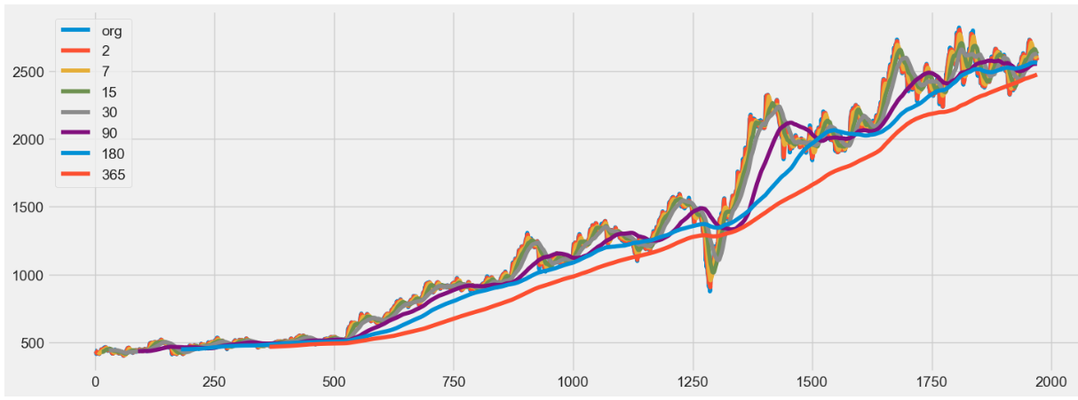

Slide 18
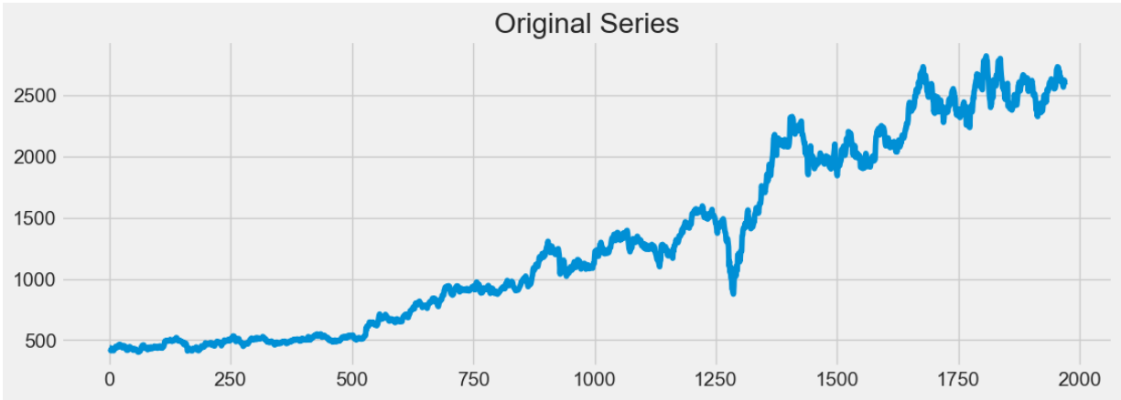
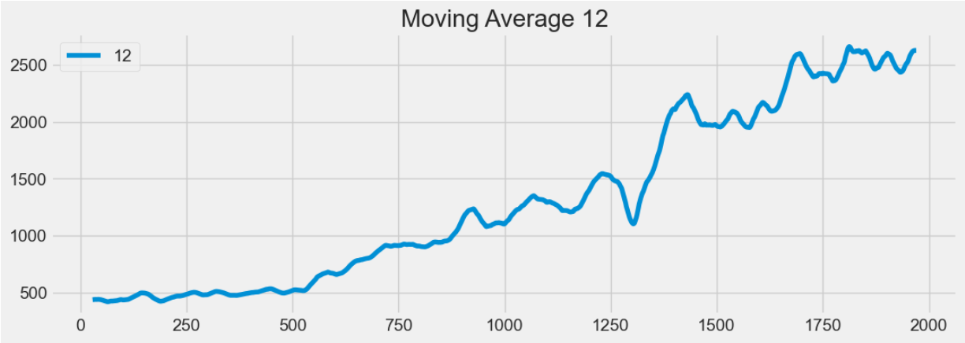

Slide 19
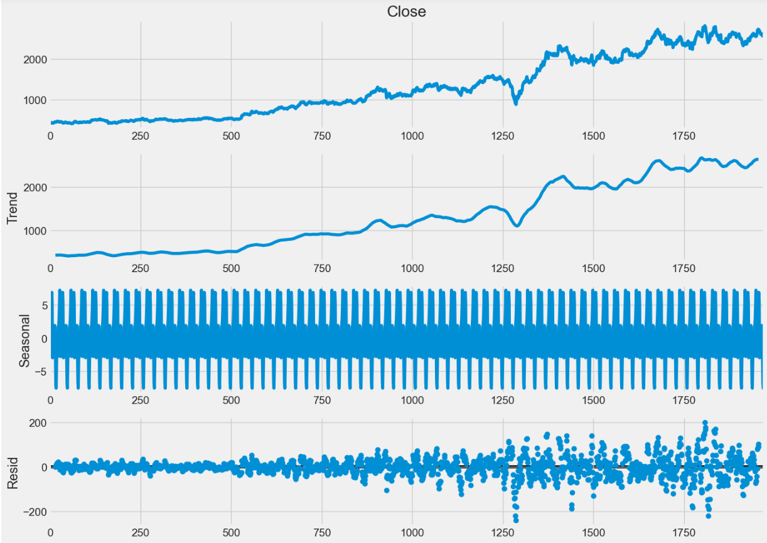
Time series decomposition plot

Slide 20
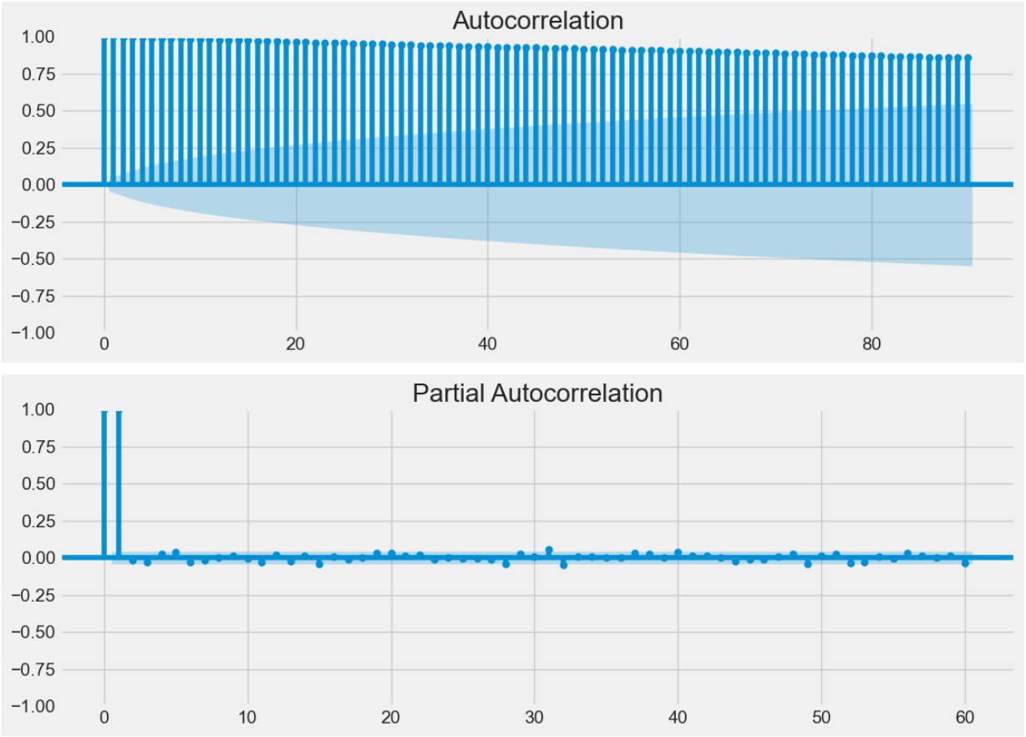
ACF and PACF plots

Slide 21
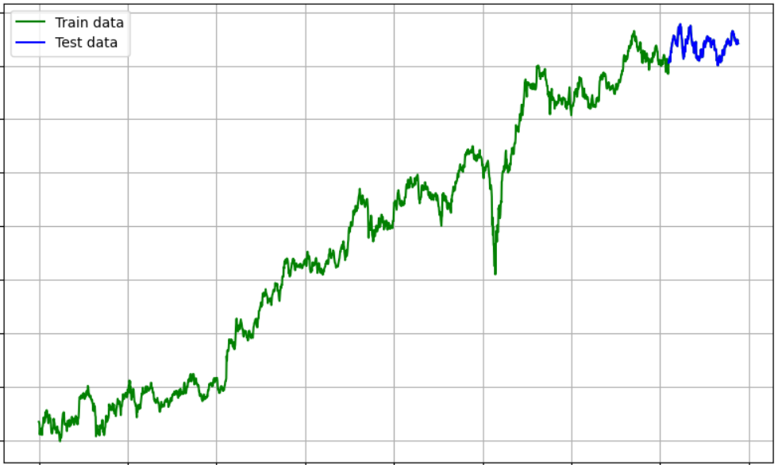
Train-Test split of the data

Slide 22
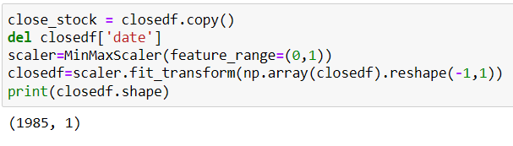
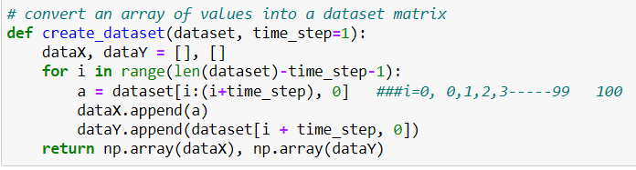
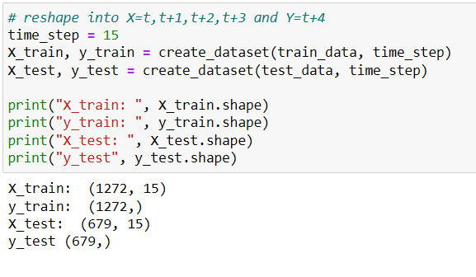
Normalizing / scaling close value between 0 to 1
Create new dataset according to requirement of time-series prediction

Slide 23
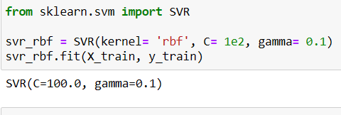
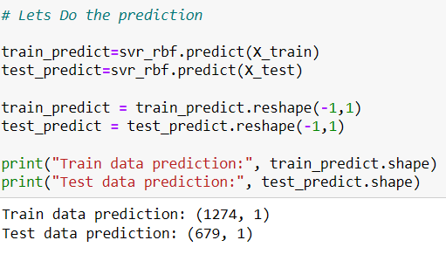
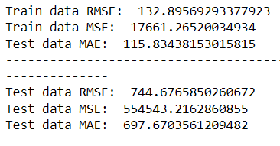
Model Building and Validation
Support vector regression - SVR
Evaluation metrices RMSE, MSE and MAE Root Mean Square Error (RMSE), Mean Square Error (MSE) and Mean absolute Error (MAE) are a standard way to measure the error of a model in predicting quantitative data.

Slide 24
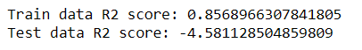
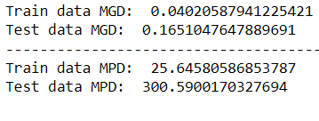
Explained variance regression score
The explained variance score explains the dispersion of errors of a given dataset, and the formula is written as follows: Here, and Var(y) is the variance of prediction errors and actual values respectively. Scores close to 1.0 are highly desired, indicating better squares of standard deviations of errors.S
R2 score for regression
R-squared (R2) is a statistical measure that represents the proportion of the variance for a dependent variable that's explained by an independent variable or variables in a regression model.
Regression Loss Mean Gamma deviance regression loss (MGD) and Mean Poisson deviance regression loss (MPD)

Slide 25
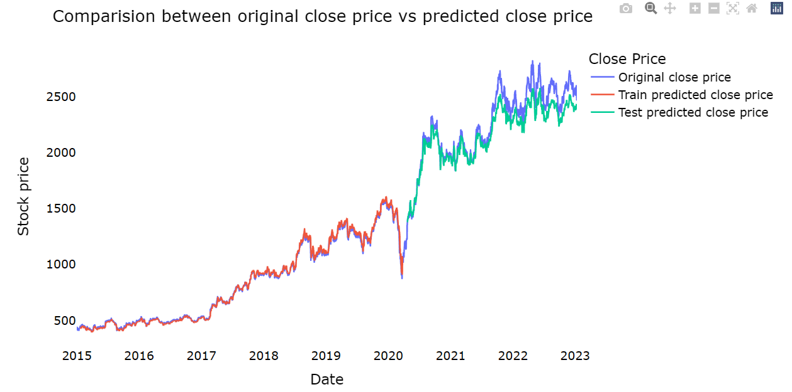
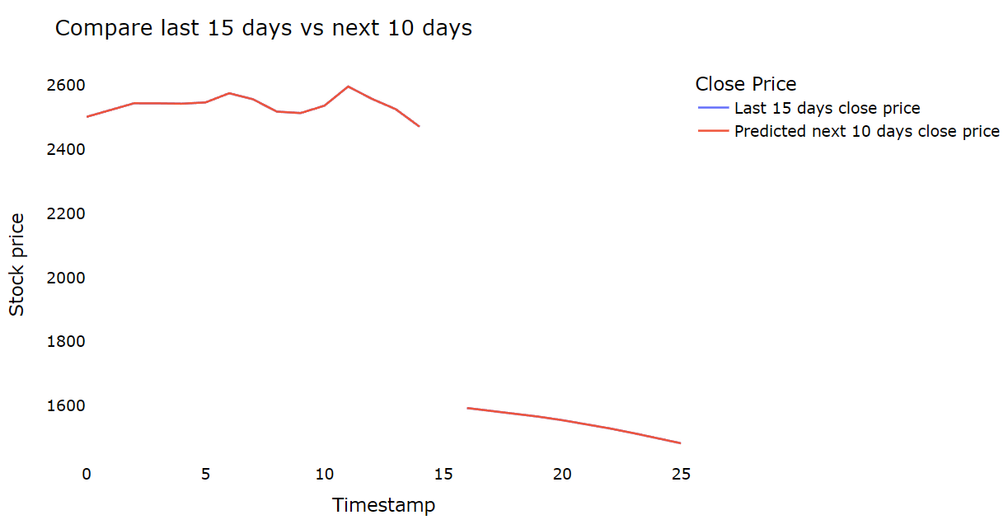
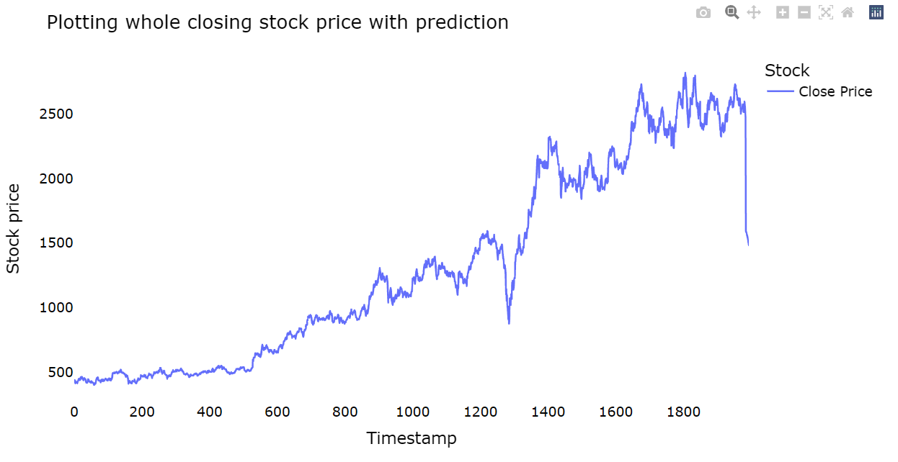

Slide 26
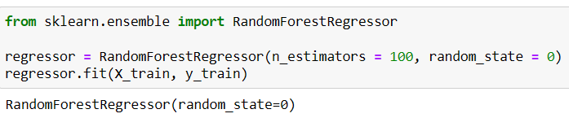




Random Forest Regressor - RF
Explained variance regression score
R2 score for regression
Regression Loss Mean Gamma deviance regression loss (MGD) and Mean Poisson deviance regression loss (MPD)
Evaluation metrices RMSE, MSE and MAE

Slide 27




Slide 28





K-nearest neighgbour - KNN
Explained variance regression score
R2 score for regression
Regression Loss Mean Gamma deviance regression loss (MGD) and Mean Poisson deviance regression loss (MPD)
Evaluation metrices RMSE, MSE and MAE

Slide 29




Slide 30





LSTM (Long short-term memory)
Evaluation metrices RMSE, MSE and MAE
Explained variance regression score
R2 score for regression
Regression Loss Mean Gamma deviance regression loss (MGD) and Mean Poisson deviance regression loss (MPD)

Slide 31




Slide 32





GRU (Gated Recurrent Unit)
Evaluation metrices RMSE, MSE and MAE
Explained variance regression score
R2 score for regression
Regression Loss Mean Gamma deviance regression loss (MGD) and Mean Poisson deviance regression loss (MPD)

Slide 33




Slide 34





LSTM + GRU
Evaluation metrices RMSE, MSE and MAE
Explained variance regression score
R2 score for regression
Regression Loss Mean Gamma deviance regression loss (MGD) and Mean Poisson deviance regression loss (MPD)

Slide 35




Slide 36


Conclusion Chart

Slide 37



Deployment

Slide 38



Slide 39




Slide 40



